Slide 1

Project Report on Survey Management
Submitted BY: Kaushal kumar Submitted TO:- MR MUKESH Kumar JANGID
Id:- 1911985071

Slide 2
अवलोकनम् Niriksha
So where this name came from and what's the meaning of this NAME?
While doing the research for the project, I had this thing in my mind that I would name my project something cool and interesting. So, when the time came to select the name for the project website, there was a lot of research going on but name couldn’t be decided because all the name that were coming to mind were very common and they were not able to create an impact on the reader.
Somehow during the research for it, I came got a name “Survey Scout” which seemed quite interesting. But wait I still didn’t felt the name as creating a impact or catching an eye and io decided to do a little more research and search their meaning in Sanskrit and finally I got the translations as अवलोकनम् Niriksha where survey translates to अवलोकनम् and scout translates to Niriksha

Slide 3
INTRODUCTION
The main aim of developing this online survey system is to conduct an online survey on different topics to the users. In this Java Application, the user can take part in various online polls. In this system of survey, only the users authenticated by admin from the database system can drop their vote or express their viewpoint regarding the issue. Being online software, it can be logged on from anywhere with internet access. Admin in this application will add the polls regarding different questions and different topics and he can see the results of each poll in the pie chart.
Overall this project of ours is being developed to help the person taking the survey as well as person giving the survey in the best way possible and also reduce the human efforts.

Slide 4
requirements Of topic
The project aims and objectives that will be achieved after completion of this project are discussed . The aims and objectives are as follows:
Ability to take survey online
Login page where User or An Organization should login.
User profile and dashboard to view Survey.
Admin page where admin can create, view and edit Survey
An Admin page which shows result of survey
A Page where admin can add Question to existing Survey
Admin page which shows result of survey

Slide 5
Online survey or internet survey, is one of the most popular data collection resources, where a set of Survey Question is sent out to a target sample and the members of this sample can respond to the questions over the world wide web. Respondents receive online surveys via various mediums such as email, embedded over website, social media etc.
Organizations implement online surveys to use the internet in order to gain insights and feedback about upcoming products or services, change in marketing strategies, enhancement in current features etc. With the progress made by the internet, more and more organizations depend on the data received and analysed from online surveys to make integral changes in their functioning. For efficient data collection, organizations must choose an advanced and efficient Online Survey Platform.
All these modules are able to help People / Organization take Survey with more convenience and in a more efficient way as compared to survey systems which are not computerized

Slide 6
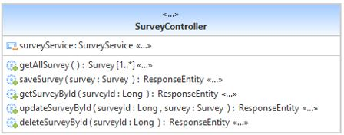
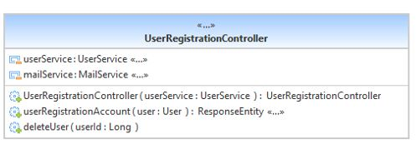
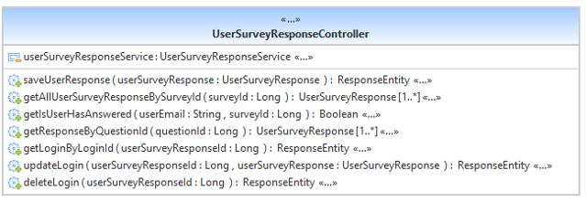
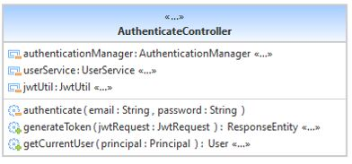
Uml diagram

Slide 7
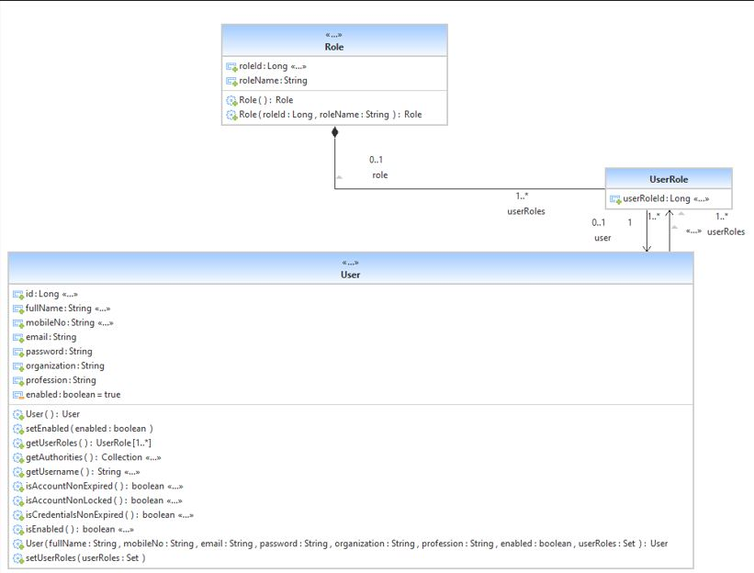
Uml :-

Slide 8
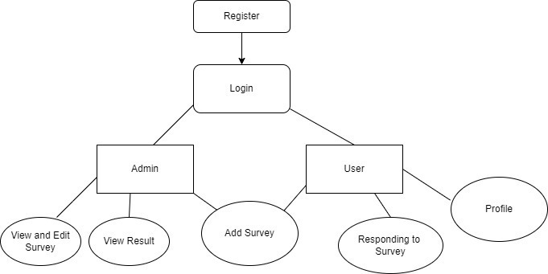
dfd

Slide 9
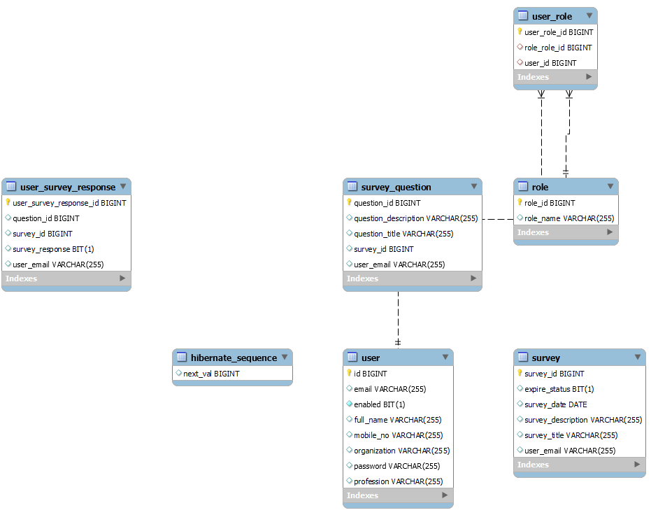
Entity Representation Diagram

Slide 10




Technologies used
FRONT-END
:- Angular JS
BACK-END
:- Spring-Boot
:-JWT
DBMS
:- MY-SQL

Slide 11

FRONTEND:- Angular js
Angular is an application design framework and development platform for creating efficient and sophisticated single-page apps.
Angular is a development platform, built on TypeScript As a platform, Angular includes:
A component-based framework for building scalable web applications
A collection of well-integrated libraries that cover a wide variety of features, including routing, forms management, client-server communication, and more
A suite of developer tools to help you develop, build, test, and update your code

Slide 12

Back-end:- Spring-boot
Spring Boot helps you to create stand-alone, production-grade
spring-based applications that you can run
Spring Boot is used to create Java applications that can be started by using java -jar or more traditional war deployments. We also provide a command line tool that runs “spring scripts”.
Our primary goals are:
• Provide a radically faster and widely accessible getting-started experience for all Spring development.
• Be opinionated out of the box but get out of the way quickly as requirements start to diverge from the defaults. • Provide a range of non-functional features that are common to large classes of projects (such as embedded servers, security, metrics, health checks, and externalized configuration).
• Absolutely no code generation and no requirement for XML configuration.

Slide 13
Back-end:- JWt
JSON Web Token is a proposed Internet standard for creating data with optional
signature and/or optional encryption whose payload holds JSON that asserts some
number of claims. The tokens are signed either using a private secret or a public/private key.
Here are some scenarios where JSON Web Tokens are useful:-
Authorization: This is the most common scenario for using JWT. Once the user is logged in, each subsequent request will include the JWT, allowing the user to access routes, services, and resources that are permitted with that token.
Information Exchange: JSON Web Tokens are a good way of securely transmitting information between parties. Because JWTs can be signed—for example, using public/private key pairs—you can be sure the senders are who they say they are.

Slide 14
Database:-my-sql
MySQL, the most popular Open Source SQL database management
system, is developed, distributed supported by Oracle Corporation.
Some Of the features are:
Works on many different platforms.
Written in C and C++.
Uses multi-layered server design with independent modules.
Designed to be fully multithreaded using kernel threads, to easily use multiple CPUs if they are available.
Provides transactional and non-transactional storage engines.
Uses a very fast thread-based memory allocation system.

Slide 15
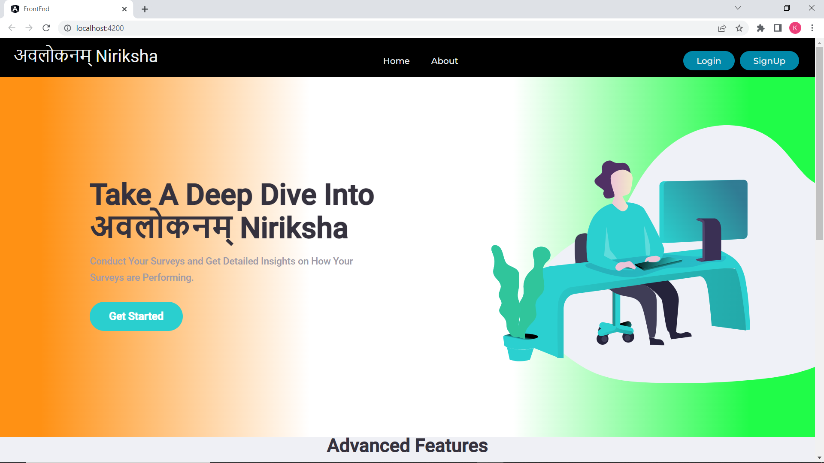
Screenshots
Home Page

Slide 16
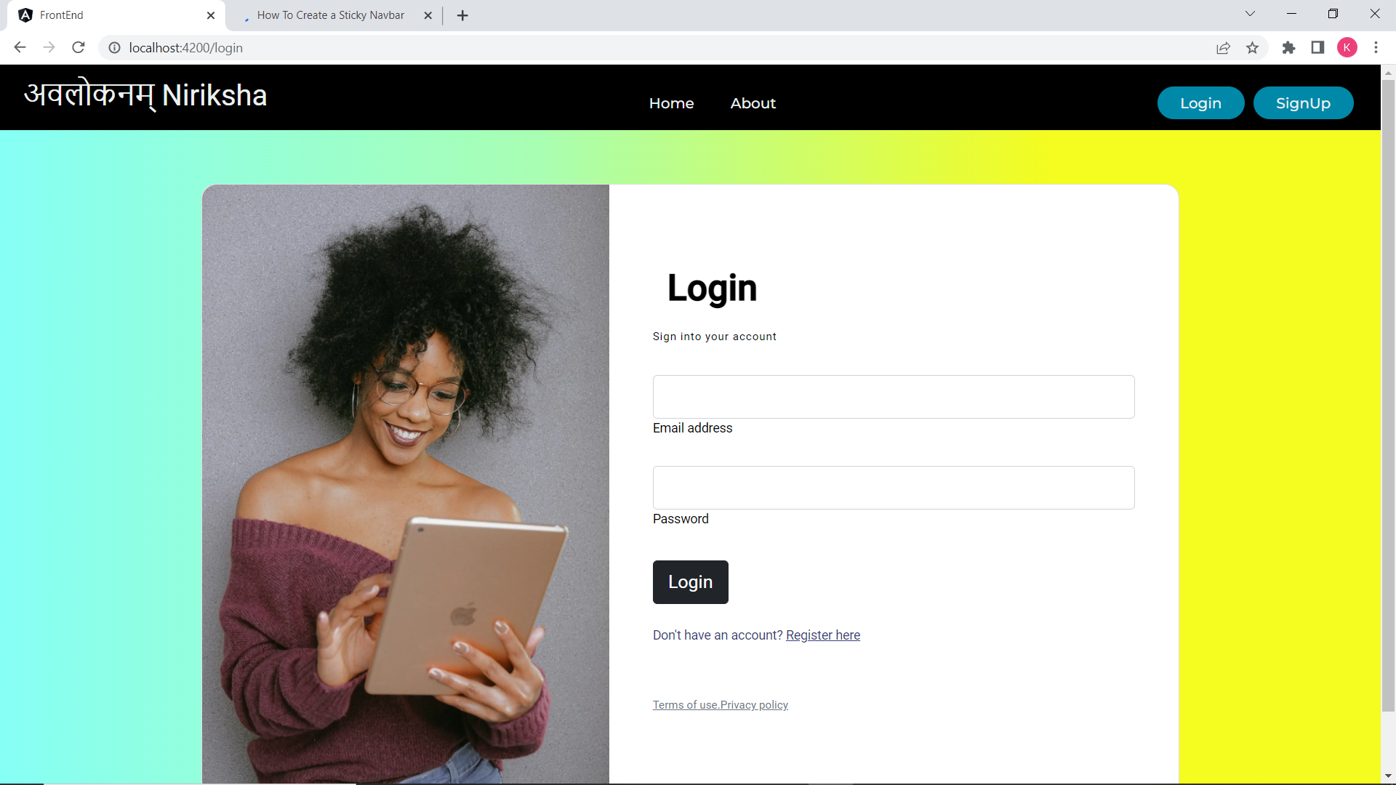
Login Page

Slide 17
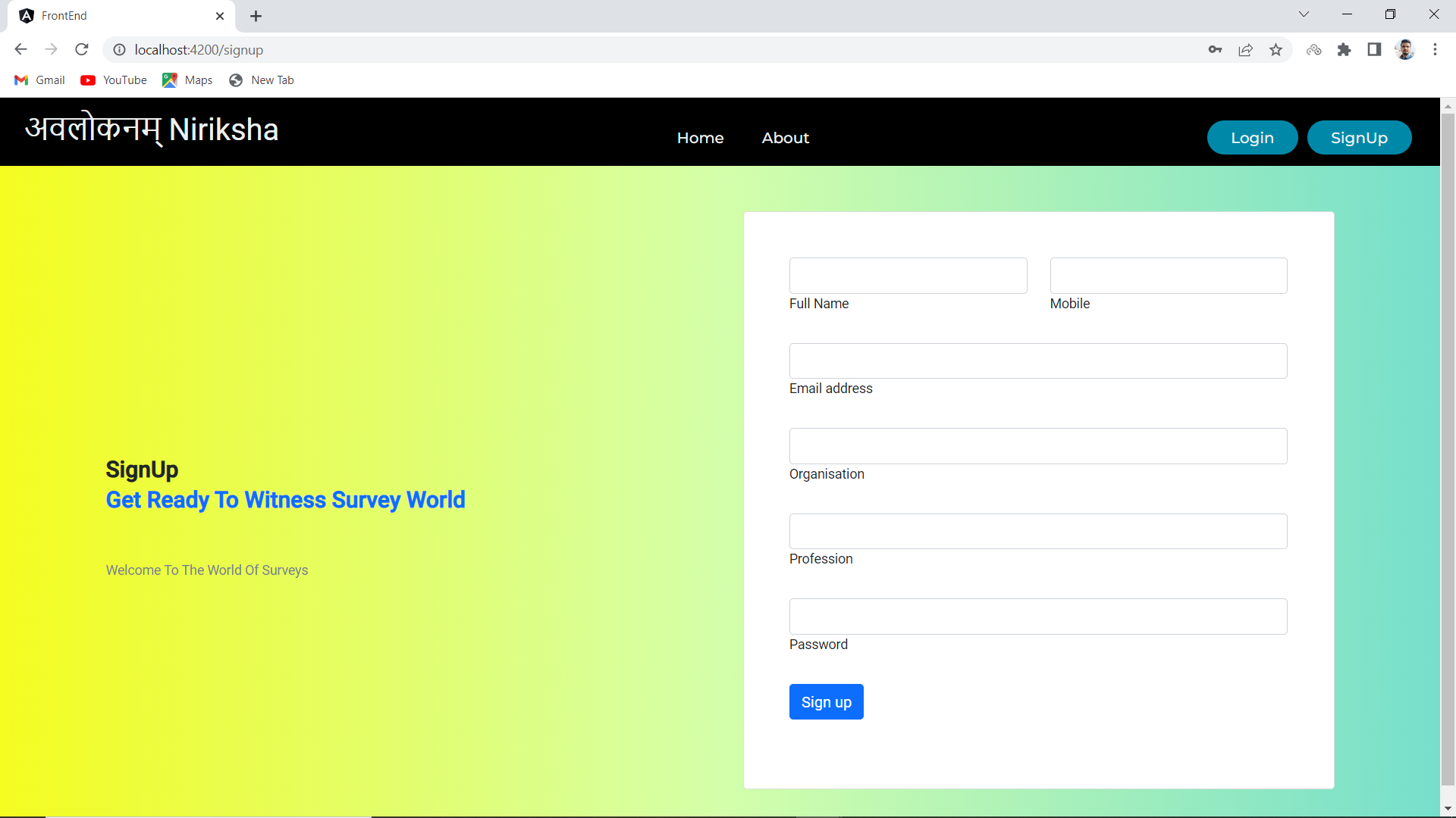
Sign Up

Slide 18
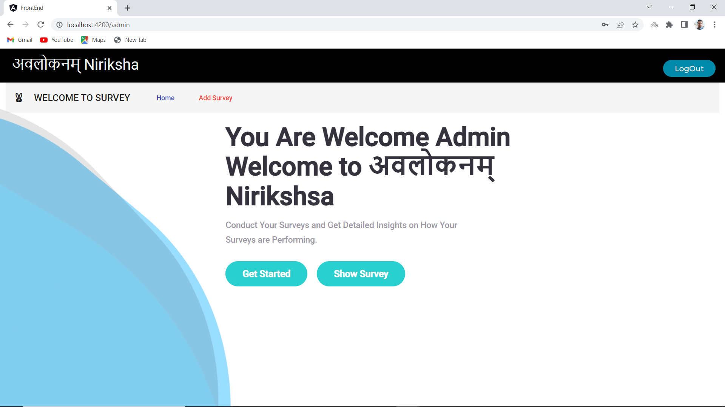
Admin Home

Slide 19
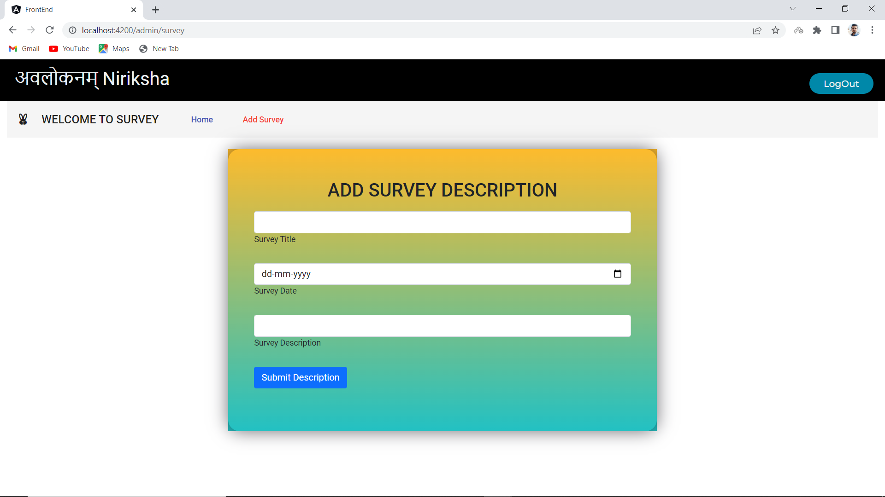
Survey Description

Slide 20
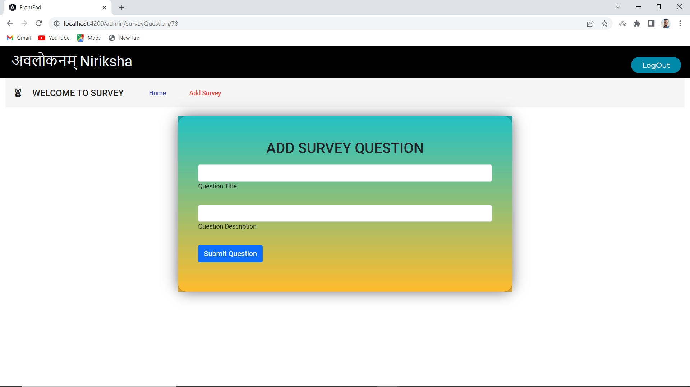

Slide 21
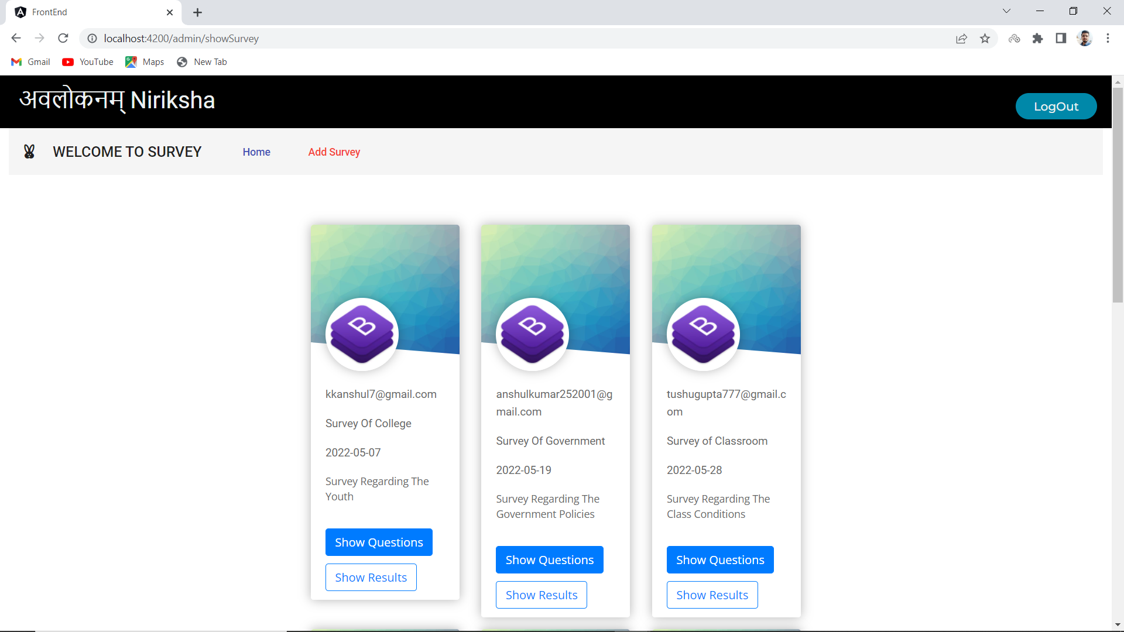
Admin Survey Page

Slide 22
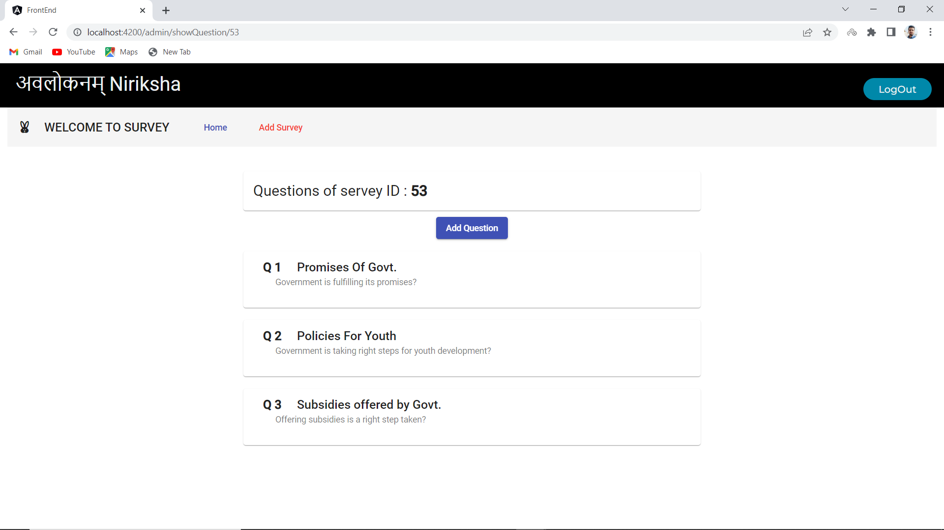
Admin Question Page

Slide 23
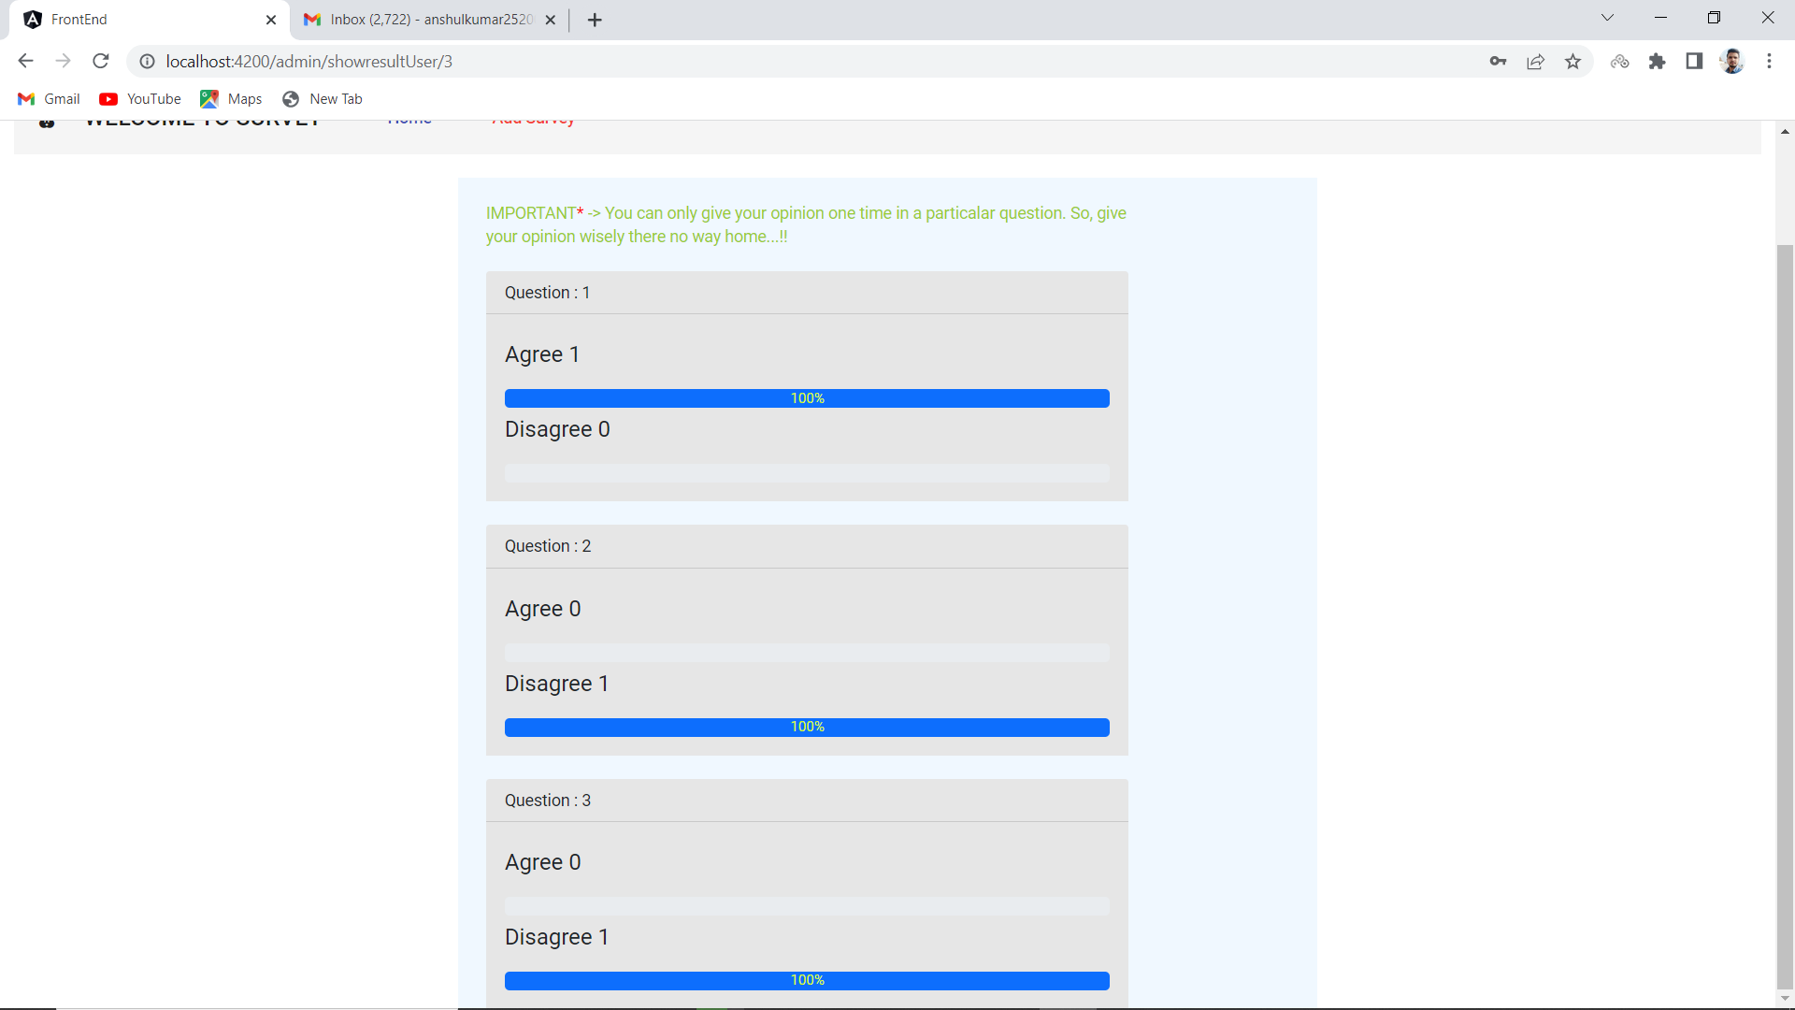
ADMIN RESULT PAGE

Slide 24
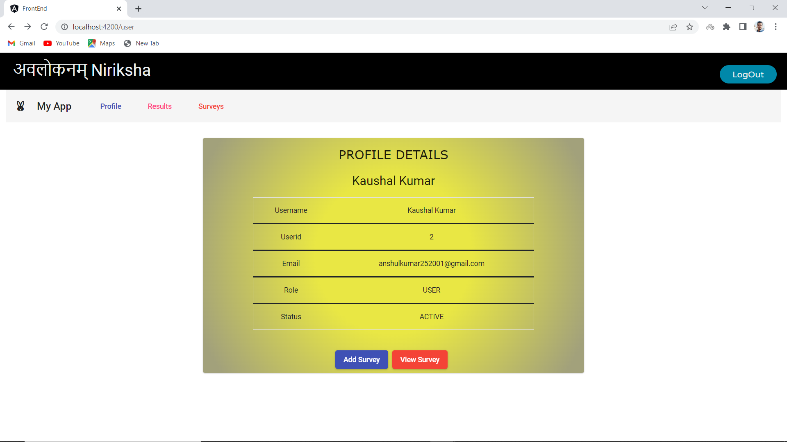
User Home Profile

Slide 25
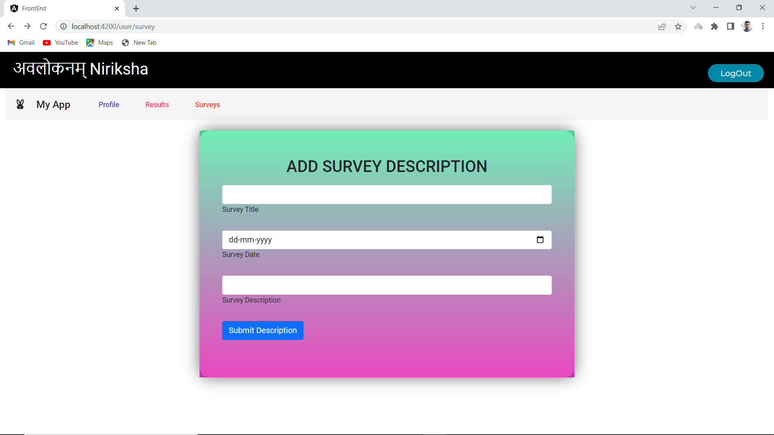

Slide 26
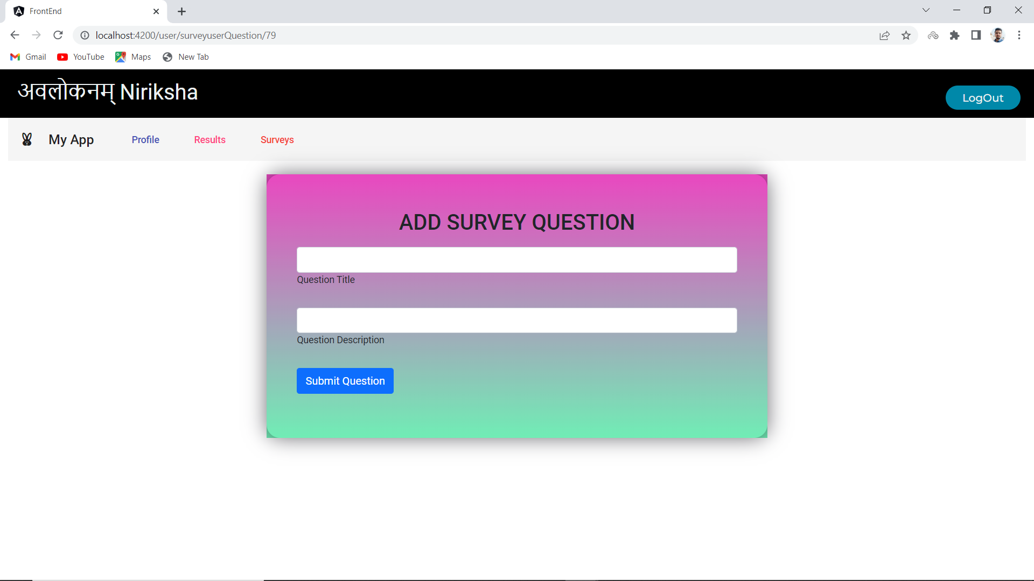

Slide 27
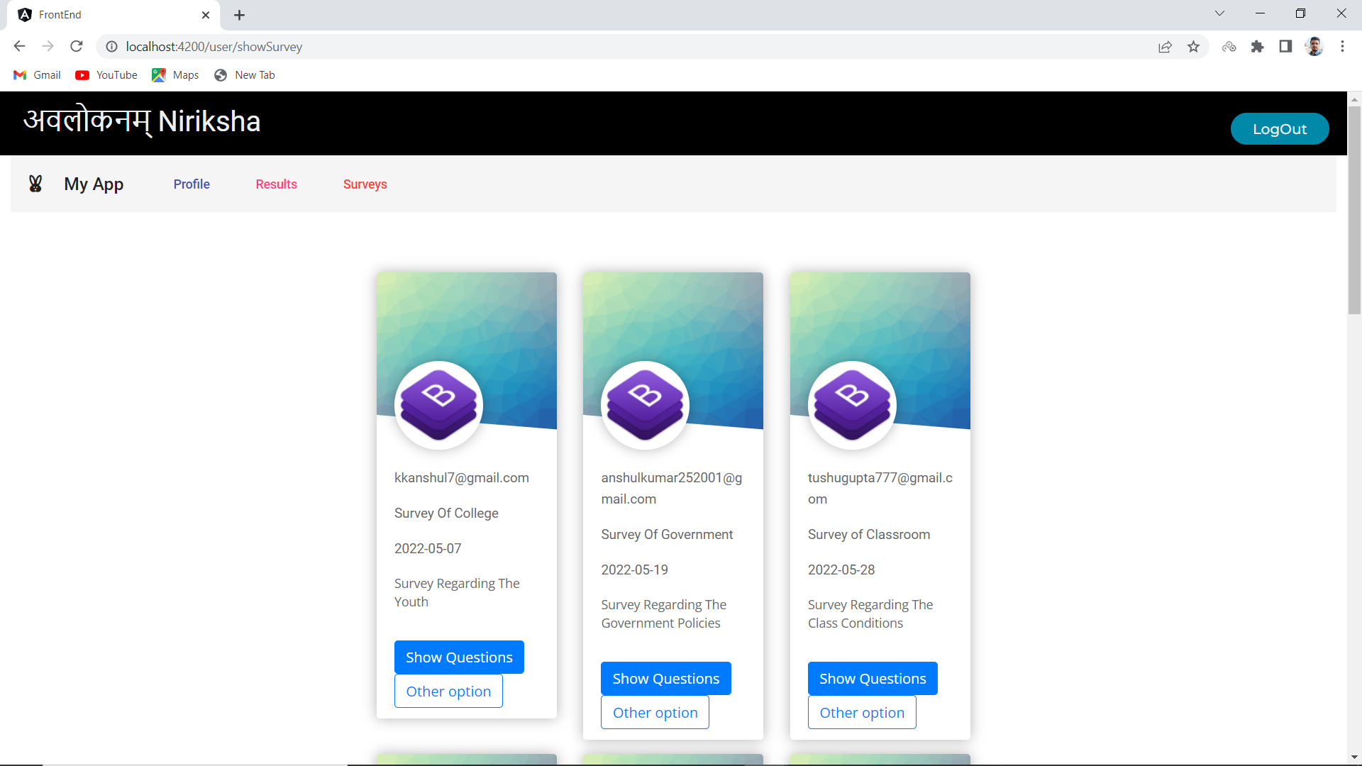

Slide 28
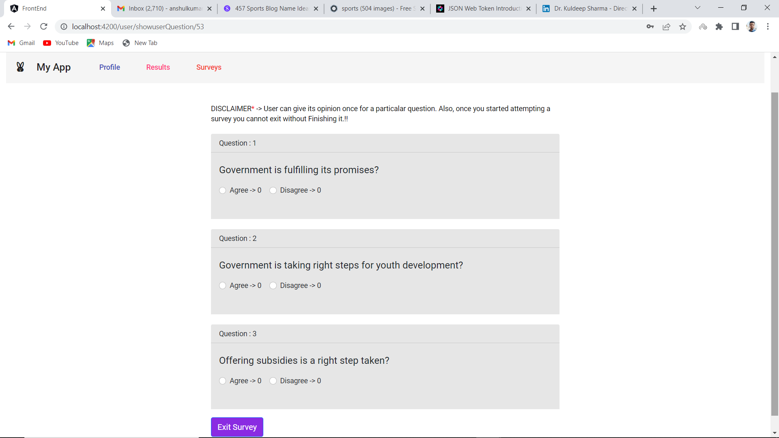

Slide 29
FUTURE SCOPE
In the Coming times where freedom of speech and freedom of expression is going to be promoted greatly on Various social sites and platforms, then our survey Site is going to play a vital role in promoting the same with more advanced and advantageous features.
Also opinion of a common man is also considered important as these small opinions takes the face of big decisions and makes a big impact on what is going to happen next and how things will shape in the coming times. As we know one can approach only near perfection and there is always a scope of improvement with the change in time.
Hence our project too have some future scope of improvements which will going to make our website more easy to use and future proof.

Slide 30
Scope Of improvements in near future
Ability to login directly with G-Mail Id.
Verification and Identification Of User with Passport to avoid fake inputs.
More Admin-User Transparency While Attempting and Showing Results of Survey
Right to admin to block users trying to make fake inputs to the survey.
Right to admin to publish survey result.
Right to admin to delete the survey.
Addition of more options in the survey.
Right to edit the survey question

Slide 31
References
Geek For Geeks
Stack Overflow
Trainer
Colleagues
Youtube.com

Slide 32
Thank you

